Slide 1

Landing.Jobs Data Challenge
Data from survey 2021
Github: https://github.com/isabelmarcolino/Data4Tech_Challenge

Slide 2
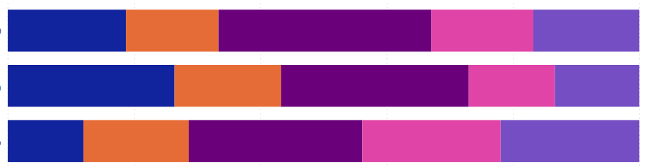
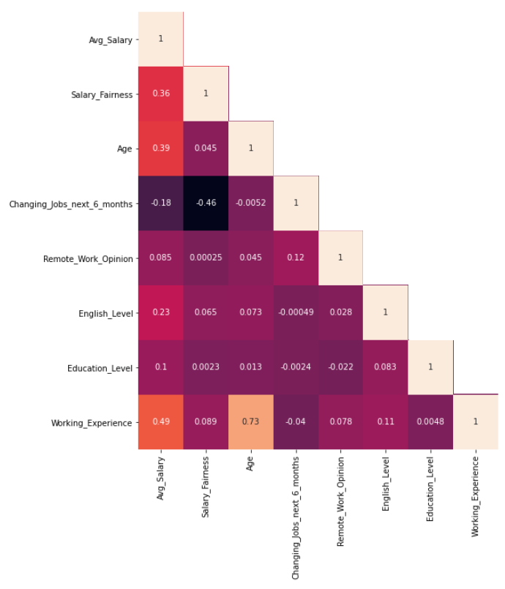
Statistical Analysis
White Circles
Salary's average is positive correlationed (increase or decrease together) with Working Experience, English Level, Age and Salary Fairness.
Remote due to Covid-19
Full or flexible remote
Full office
Level of intention for changing jobs
Yellow Circle
Remote work opinion has a slightly positive correlation with changing job next 6 months.
Conclusion
Workers who have flexibility to work remotely are less likely to change jobs next months.

Slide 3
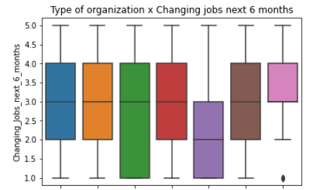
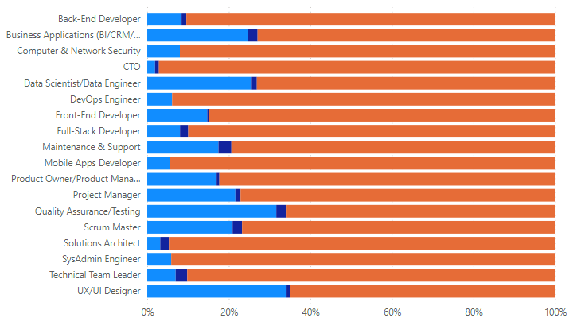

Statistical Analysis
Roles with less female representativity (< 5%): CTO and Solutions Architect.
Roles with more of female representativity (> 25%): Data Scientist/Data Engineer, Quality Assurance/Testing, UX/UI Designer.
Corporate
SME
Startup
Consulting
Unicorn
Nearshore
Outshorcing
Unicorn companies tend to provide higher and fairness salaries with workers less likely to changing jobs.

Slide 4
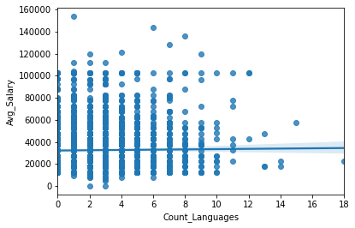
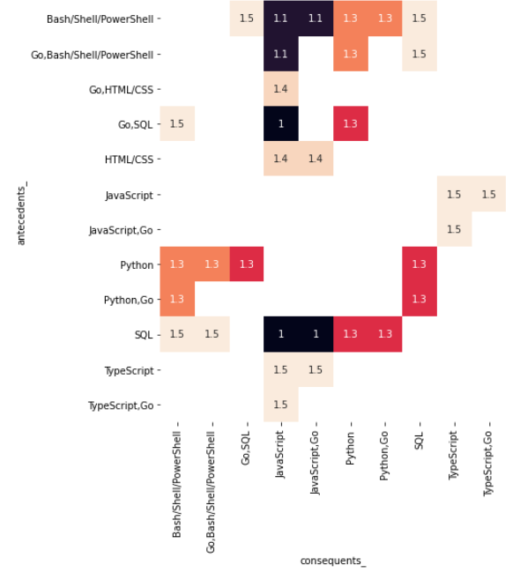
Machine Learning
In general, there is no correlation between the number of languages that a worker knows with their salary. We can extend this result, and conclude that specialists tend to earn more.
Go developers earn higher salaries and they also have background in multiple programming languages. Developers who have background in Bash/Shell/PowerShell, HTML/CSS, Javascript, Python and SQL are potencial candidate to adopt Go as well.

Slide 5
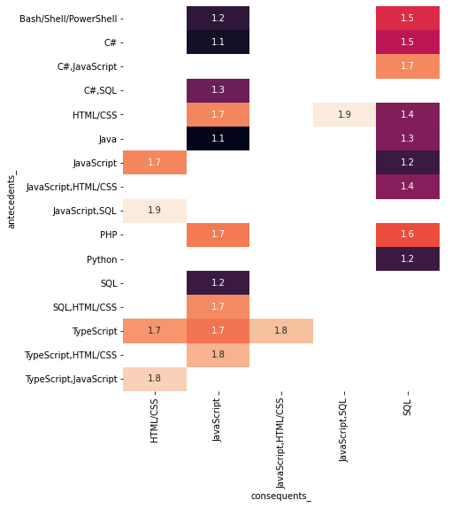
Machine Learning
Typicals tech stacks of developers were founded using Apriori algorithm.
Javascript is the most popular language and typically related to Front-End and Full-Stack developers, being learned with more sort of languages.
Full-Stack Developer:
Javascript, HTML/CSS, SQL
SQL, C#, Javascript
Javascript, Java
Javascript, C#, SQL
Javascript, PHP
Back-End Developer:
Java, SQL
C#, SQL
Front-End Developer:
Javascript, HTML/CSS
Typescript, HTML/CSS, Javascript
Data Scientist/Data Engineer:
Python, SQL
DevOps Engineer and Maintenace & Support:
Bash/Shell/PowerShell, SQL

